Slide 1
Chapter 5:
Sequential Logic Circuit

Slide 2
5.1 Flip-flop & Register
~ Latches
~ Edge-triggered flip-flops
~ Master-slave flip-flops
~ Flip-flop operating characteristics
~ Flip-flop applications
~ One
~ The 555 timer

Slide 3
Introduction
Latches and flip-flops are the basic single-bit memory elements used to build sequential circuit with one or two inputs/outputs, designed using individual logic gates and feedback loops.
Latches:
The output of a latch depends on its current inputs and on its previous output and its change of state can happen at any time when its inputs change.
Flip-Flops:
The output of a flip-flop also depends on current inputs and its previous output but the change of state occurs at specific times determined by a clock input.

Slide 4
Introduction
Latches:
S-R Latch
Gate S-R Latch
Gate D-Latch
Flip-Flops:
Edge-Triggered Flip-Flop (S-R, J-K, D)
Asynchronous Inputs
Master-Slave Flip-Flop
Flip-Flop Operating Characteristics
Flip-Flop Applications
One-shots & The 555 Timer

Slide 5
Latches
Type of temporary storage device that has two stable (bi-stable) states
Similar to flip-flop – the outputs are connected back to opposite inputs
Main difference from flip-flop is the method used for changing their state
S-R latch, Gated/Enabled S-R latch and Gated D latch

Slide 6
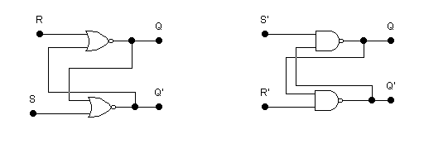
S-R (SET-RESET) Latch
Active-HIGH input S-R Latch Active-LOW input S-R Latch

Slide 7
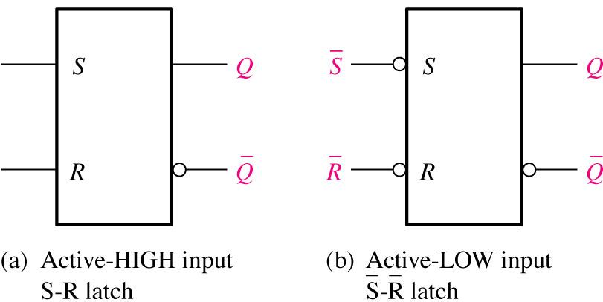
Logic symbols for the S-R and S-R latch

Slide 8
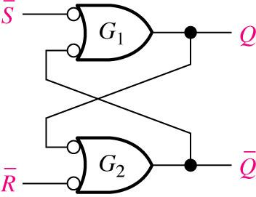
Negative-OR equivalent of the NAND gate S-R latch

Slide 9
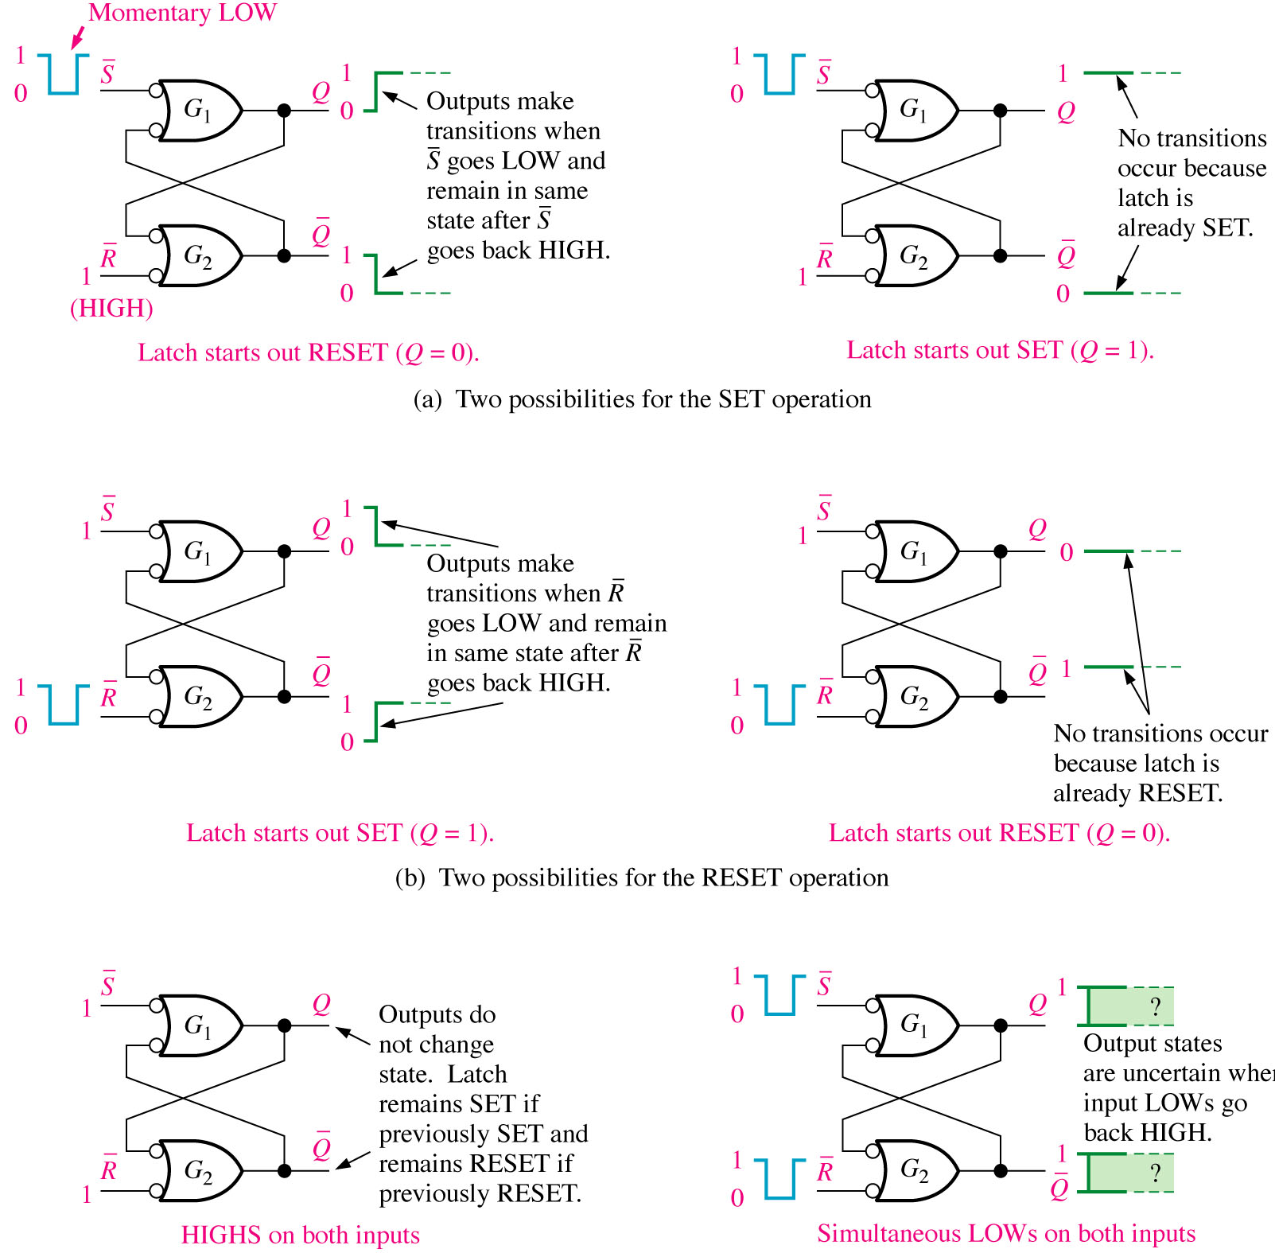

Slide 10
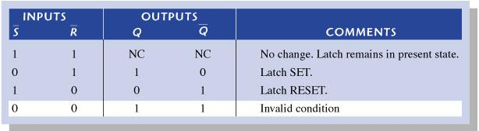
Truth table for an active-LOW input S-R latch

Slide 11
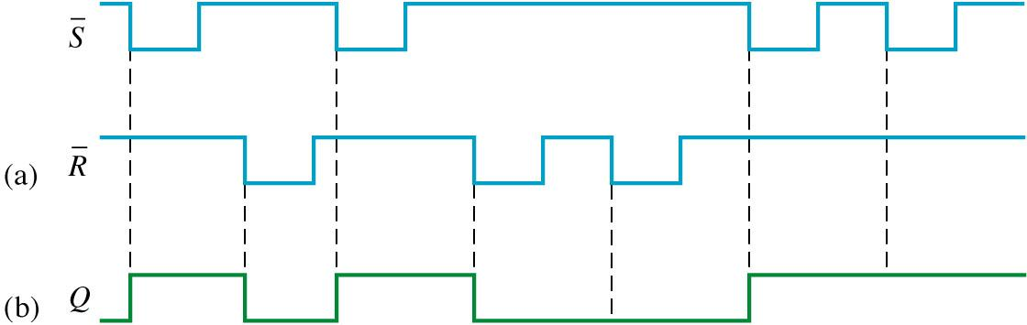
Assume that Q is initially LOW
1
2
3
4
5
6
7
Waveforms

Slide 12
Gated S-R Latch
A gate input is added to the S-R latch to make
the latch synchronous.
In order for the set and reset inputs to change
the latch, the gate input must be active
(high/Enable).
When the gate input is low, the latch remains in
the hold condition.

Slide 13
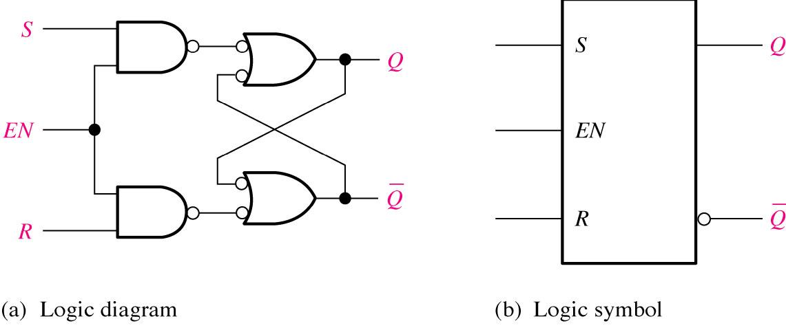
A gated S-R latch

Slide 14
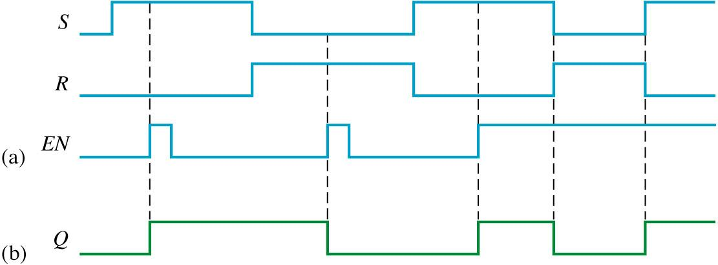
Gated S-R latch waveform:
1
2
3
4
5

Slide 15
Truth Table for Gated S-R Latch
S R G Q Q’
0 0 0 Q Q’ Hold
1 0 0 Q Q’ Hold
0 1 0 Q Q’ Hold
1 1 0 Q Q’ hold
0 0 1 Q Q’ hold
1 0 1 1 0 set
0 1 1 0 1 reset
1 1 1 0 0 not allowed

Slide 16
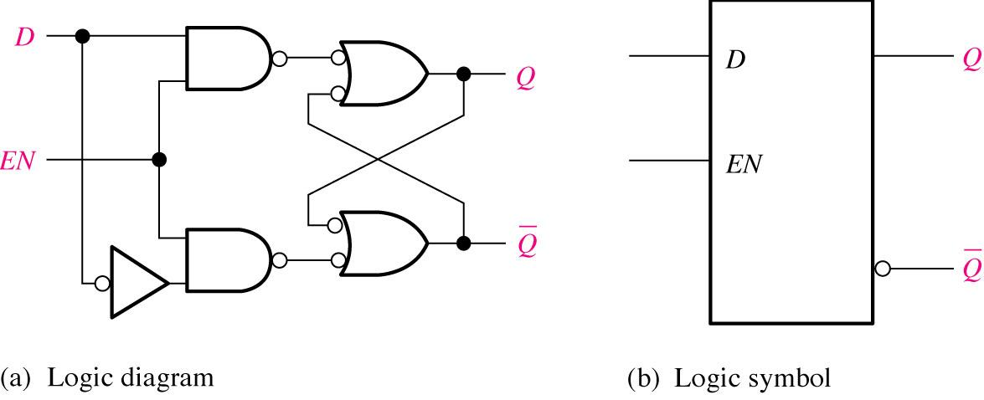
Gated D Latch (74LS75)
The D (data) latch has a single input that is used to set and to
reset the flip-flop.
When the gate is high, the Q output will follow the D input.
When the gate is low, the Q output will hold.

Slide 17
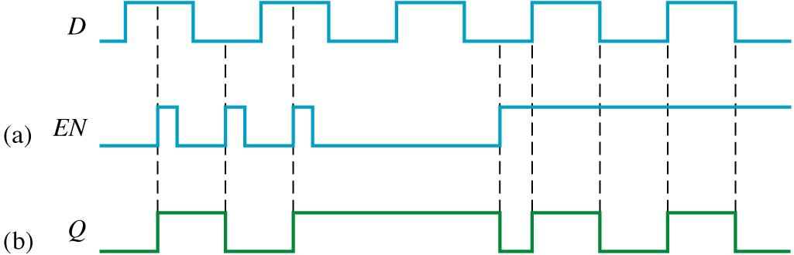
Gated S-R Latch Q output waveform if the inputs are as shown:
The output follows the input when the gate is high but is in a hold
when the gate is low.

Slide 18
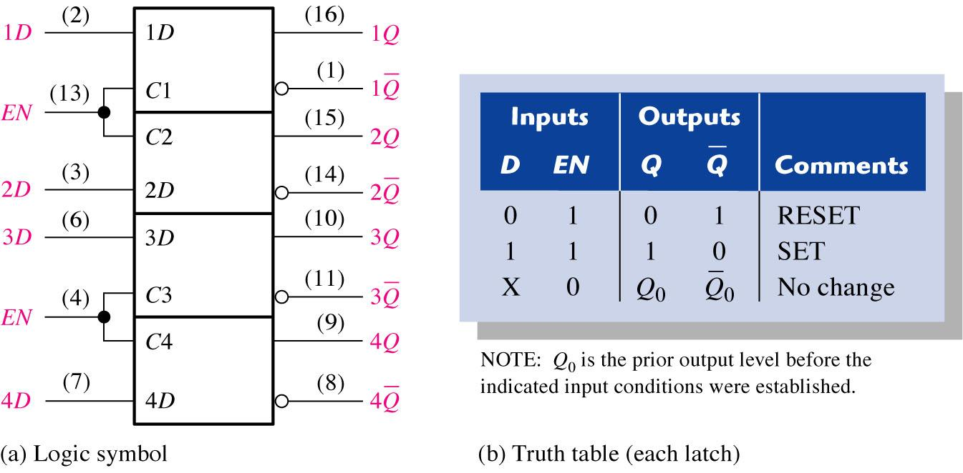
Gated D Latch (74LS75)

Slide 19
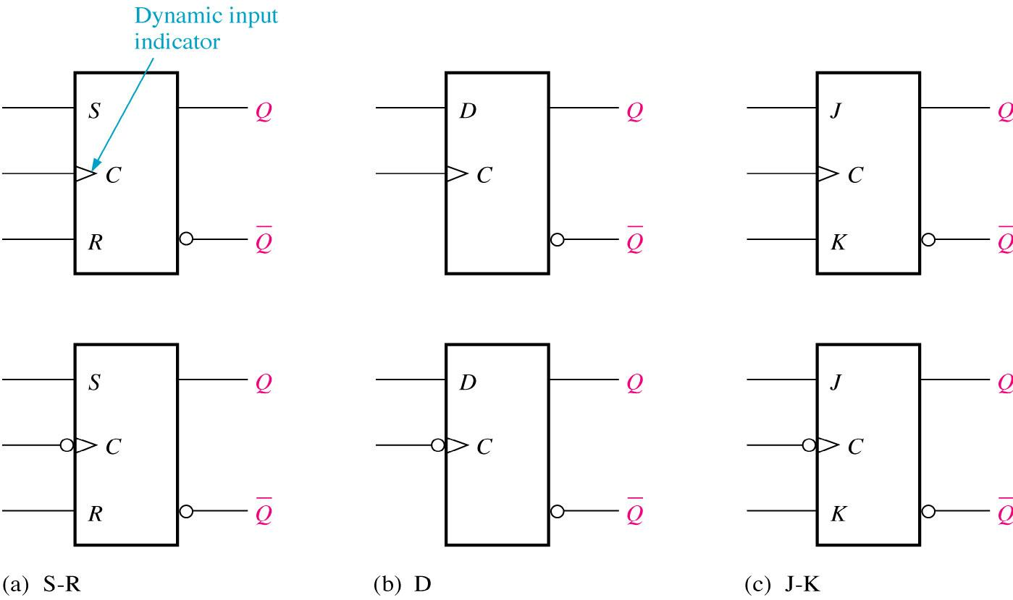
Edge-triggered Flip-flop Logic Positive edge triggered and Negative edge-triggered
All the above flip-flops have the triggering input called clock (CLK/C)

Slide 20
Clock Signals & Synchronous Sequential Circuits
1
Clock signal
0
Clock Cycle
Time
Rising edges of the clock
(Positive-edge triggered)
Falling edges
of the clock
(Negative-edge triggered)
A clock signal is a periodic square wave that indefinitely switches values from 0 to 1 and 1 to 0 at fixed intervals.

Slide 21
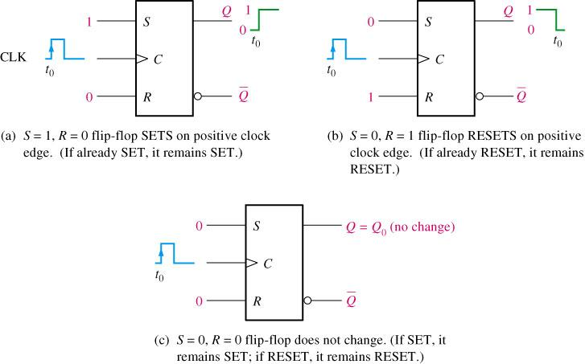
Operation of a positive edge-triggered S-R flip-flop
(d) S=1, R=1
is invalid or not allowed

Slide 22
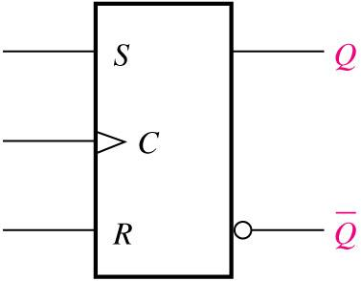
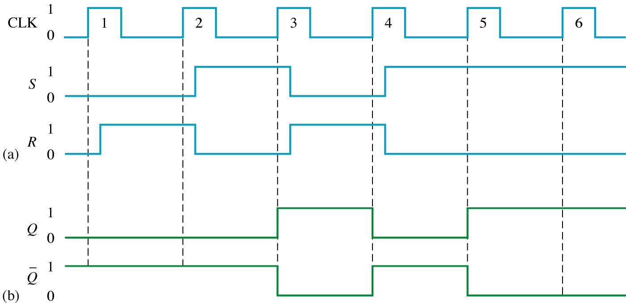
Example:

Slide 23
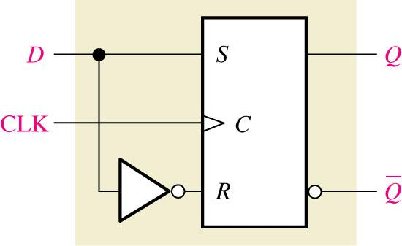
A positive edge-triggered D flip-flop formed with an S-R flip-flop and an inverter.
D CLK/C Q Q’_________________
1 ↑ 1 0 SET (stores a 1)
0 ↑ 0 1 RESET (stores a 0)

Slide 24
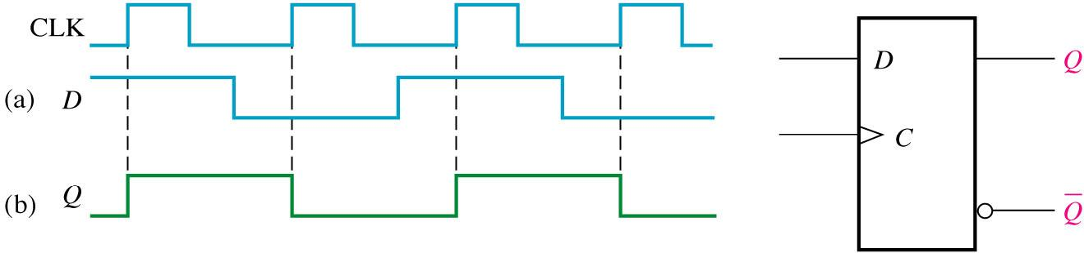
Example:

Slide 25
Truth Table for J-K Flip Flop
J K CLK Q Q’
0 0 Q₀ Q₀’ Hold
0 1 0 1 Reset
1 0 1 0 Set
1 1 Q₀’ Q₀ Toggle (opposite state)

Slide 26
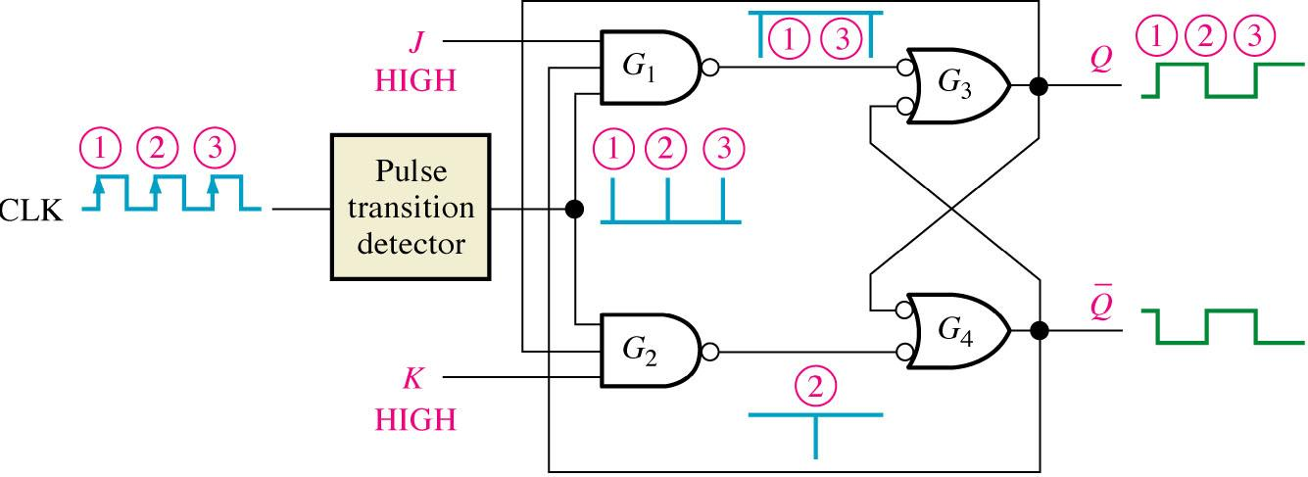
Transitions illustrating the toggle operation when J =1 and K = 1.

Slide 27
Edge-triggered J-K flip-flop
The edge-triggered J-K will only accept the J and K
inputs during the active edge of the clock.
The small triangle on the clock input indicates that the
device is edge-triggered.
A bubble on the clock input indicates that the device
responds to the negative edge. no bubble would indicate
a positive edge-triggered device.

Slide 28
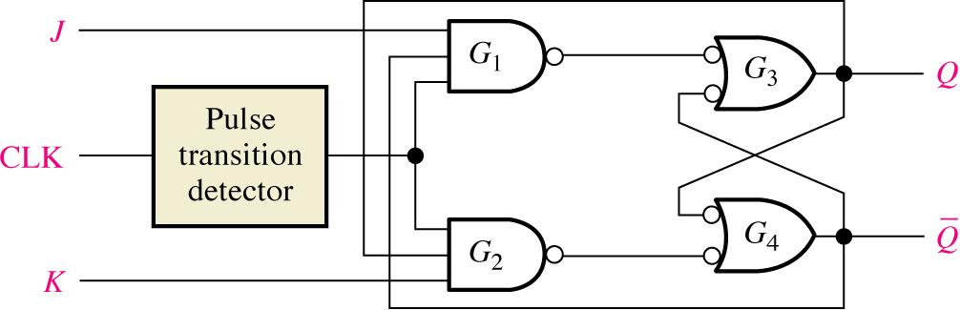
A simplified logic diagram for a positive edge-triggered J-K flip-flop.

Slide 29
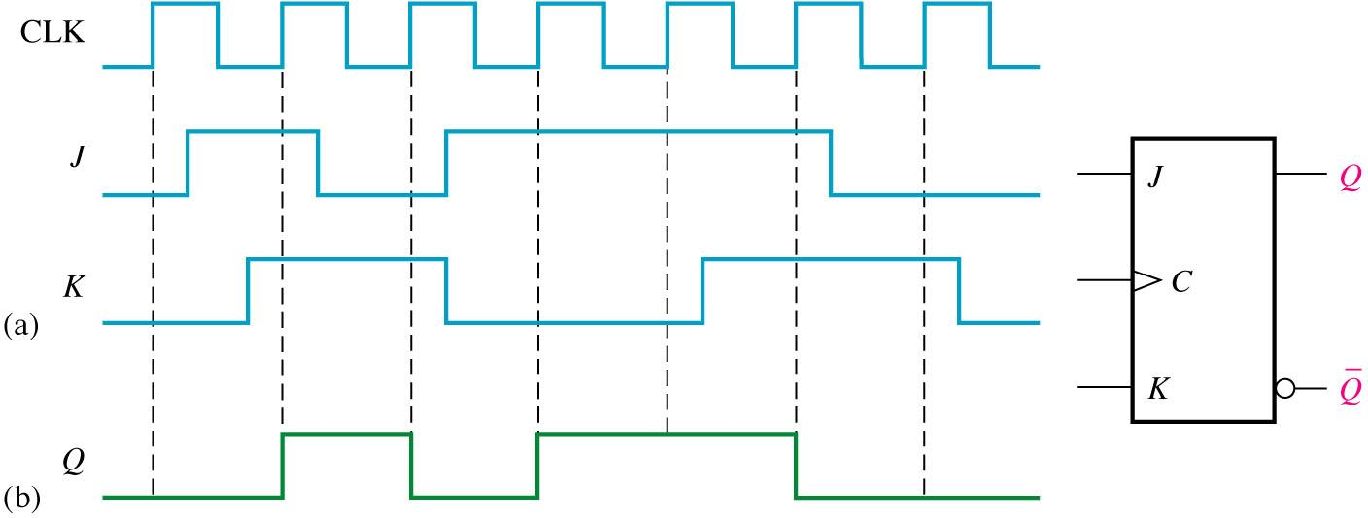
Example: Positive edge-triggered

Slide 30
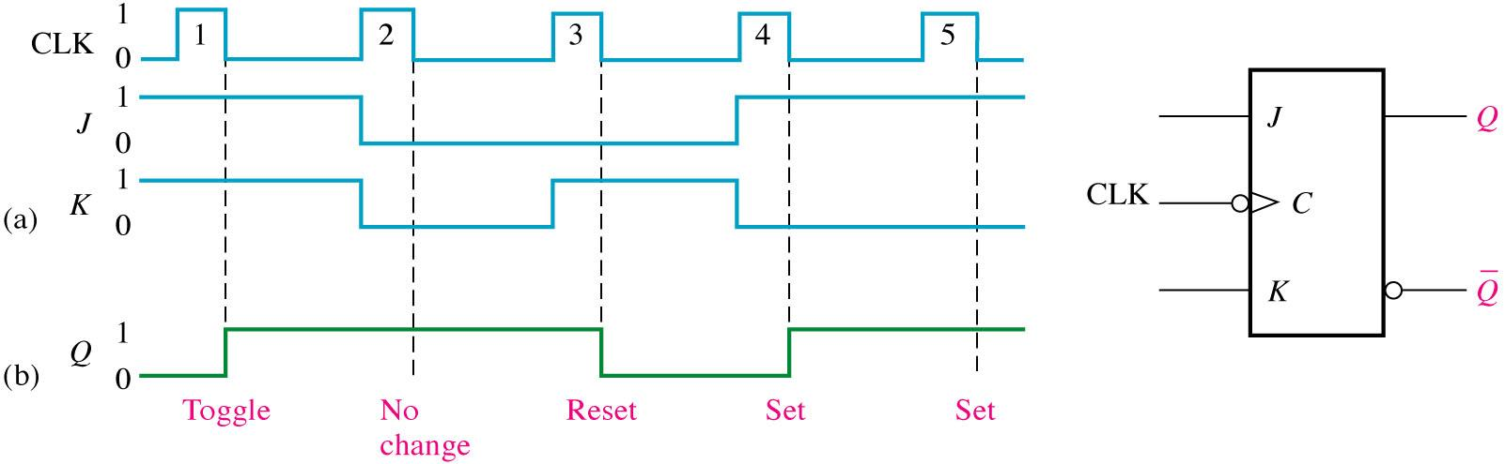
Example: Negative edge-trigerred

Slide 31
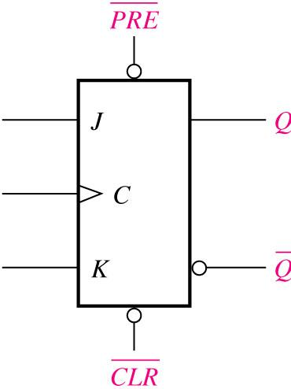
Logic symbol for a J-K flip-flop with active-LOW preset and clear inputs.

Slide 32
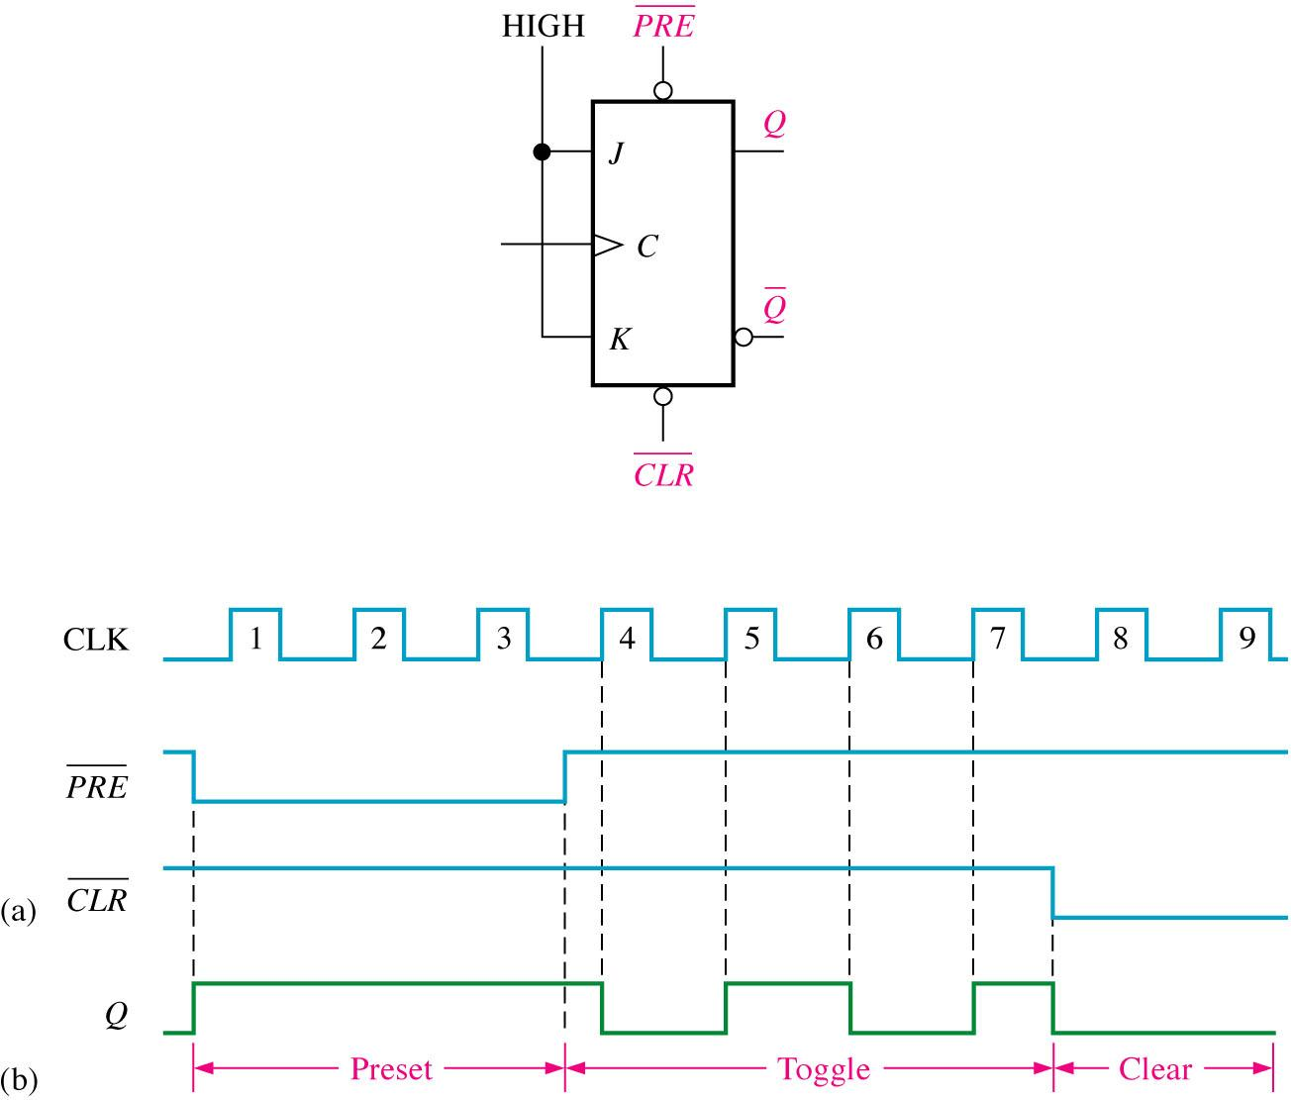
Example:

Slide 33
Edge-triggered flip-flop logic symbols (cont’d)
The J-K flip-flop has a toggle mode of operation when both
J and K inputs are high.Toggle means that the Q output
will change states on each active clock edge.
J, K and Cp are all synchronous inputs.
The master-slave flip-flop is constructed with two latches.
The master latch is loaded with the condition of the J-K inputs while
the clock is high. When the clock goes low, the slave takes on the
state of the master and the master is latched.
The master-slave is a level-triggered device.
The master-slave can interpret unwanted signals on the J-K inputs.

Slide 34
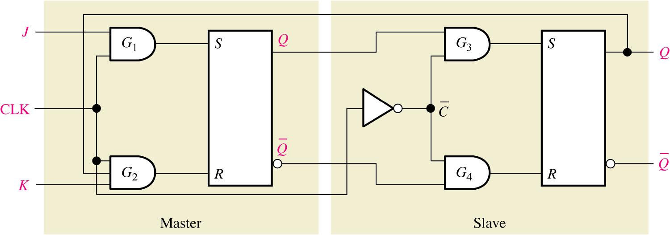
Basic logic diagram for a master-slave J-K flip-flop.

Slide 35
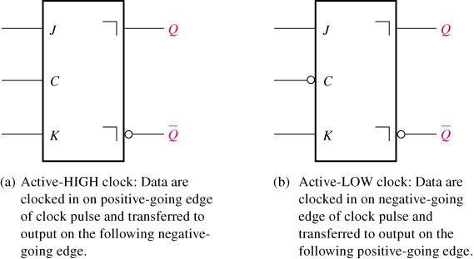
Pulse-triggered (master-slave) J-K flip-flop logic symbols.

Slide 36
Truth Table for Master-Slave J-K Flip Flop
J K CLK Q Q’
0 0 Q₀ Q₀’ Hold
0 1 0 1 Reset
1 0 1 0 Set
1 1 Q₀’ Q₀ Toggle (opposite state)

Slide 37
Flip-Flop Applications
Parallel Data Storage
Frequency Division
Counting

Slide 38
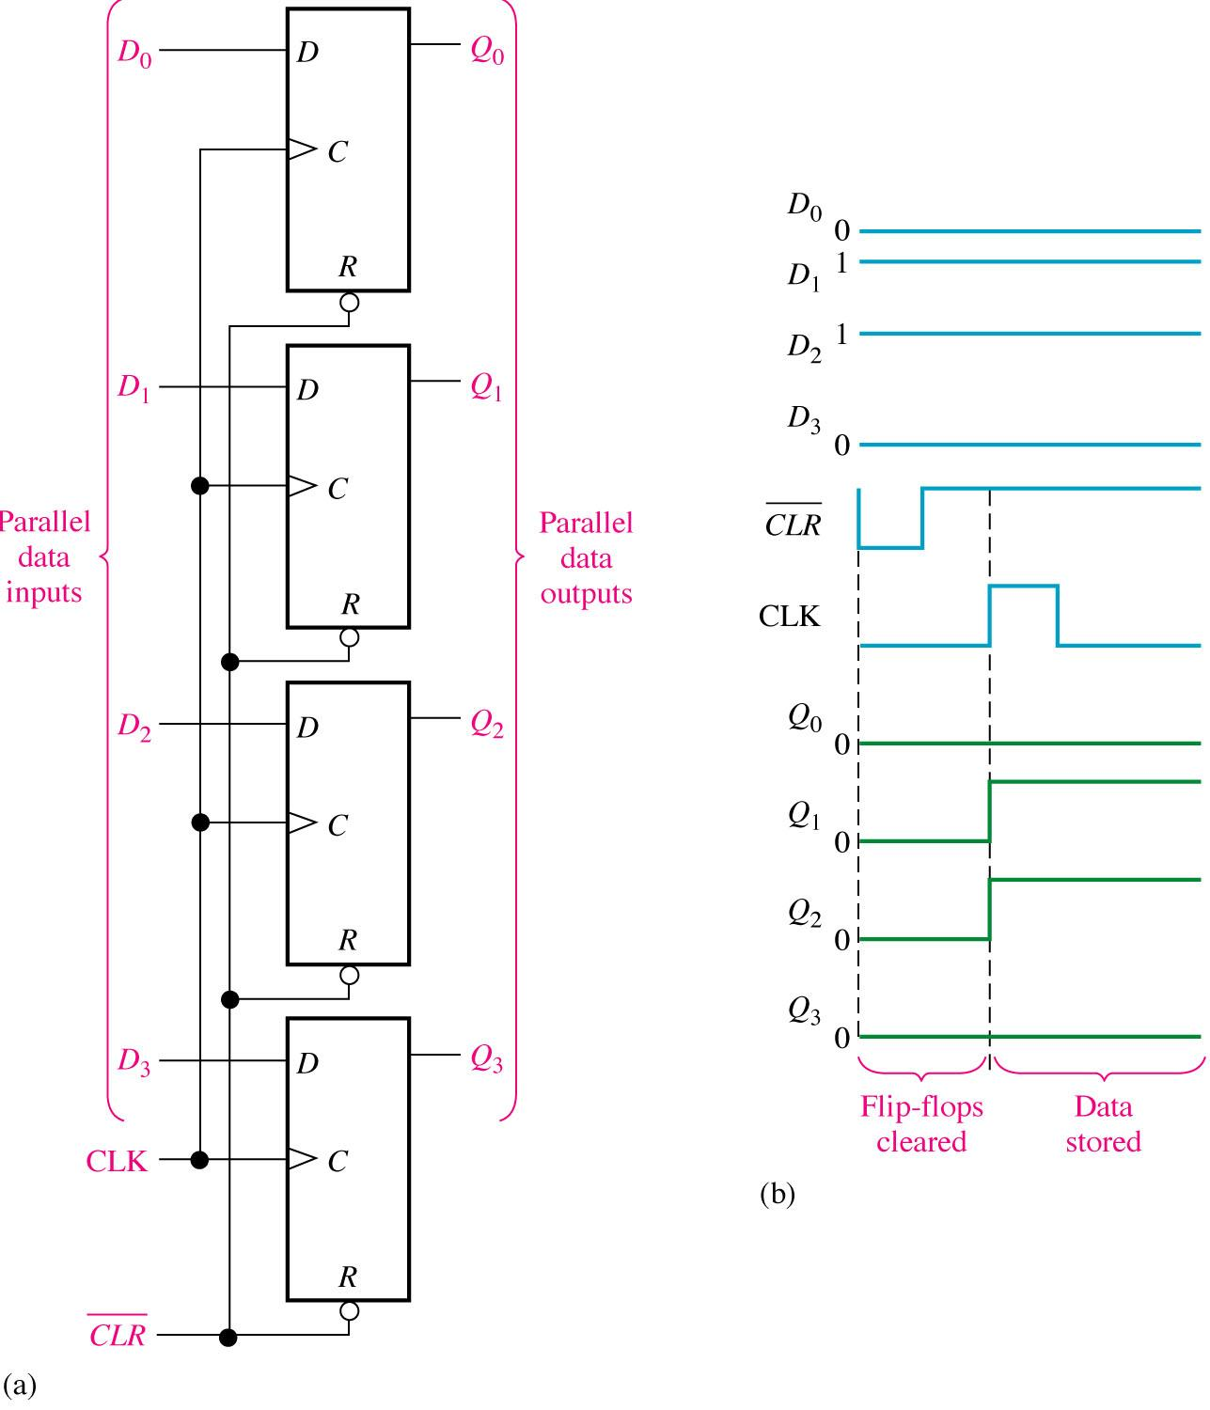
Flip-flops used in a basic register for parallel data storage.

Slide 39
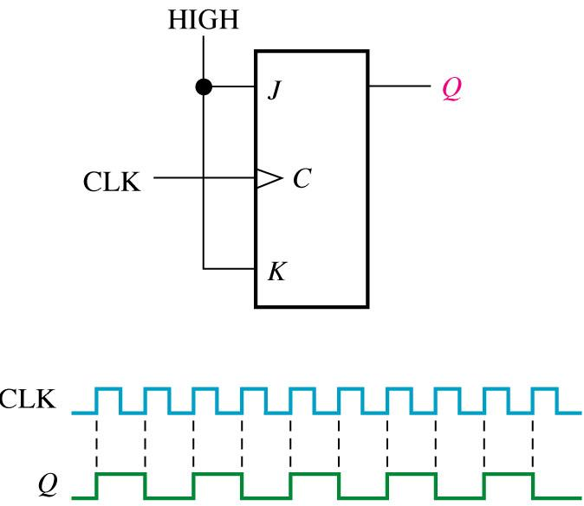
J-K flip-flop as a divide-by-2 device. Q is one-half the frequency of CLK.

Slide 40
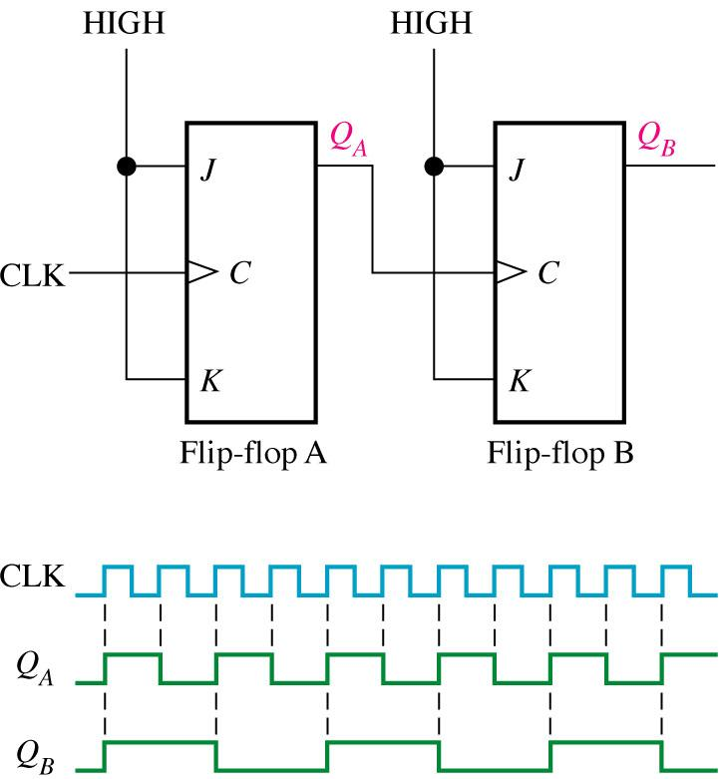
Two J-K flip-flops used to divide the clock frequency by 4. Q_{A} is one-half and Q_{B} is one-fourth the frequency of CLK.

Slide 41
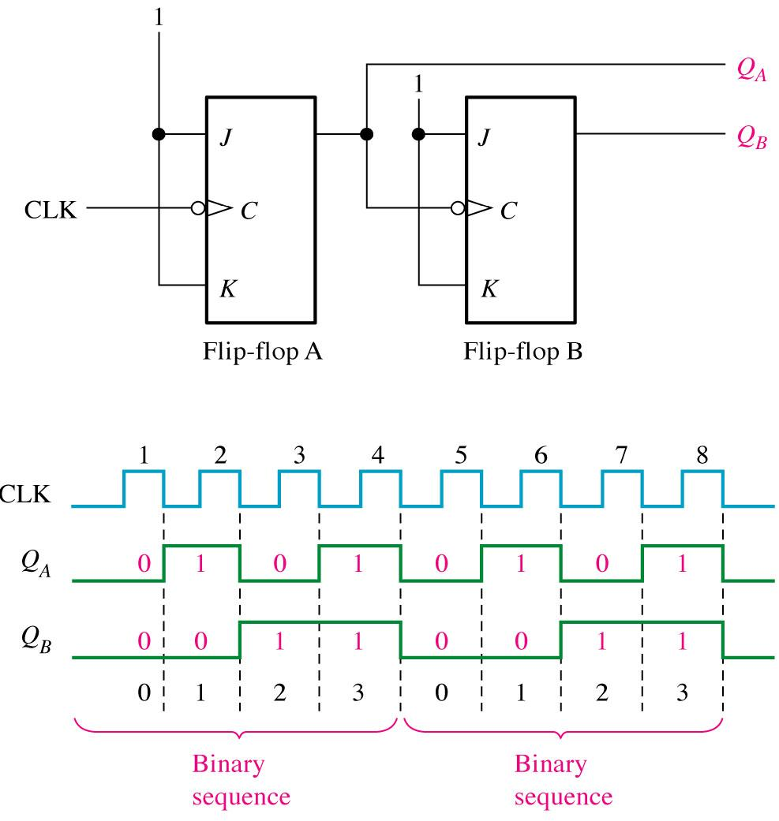
Flip-flops used to generate a binary count sequence. Two repetitions (00, 01, 10, 11) are shown.

Slide 42
Flip-Flop Operating Characteristics
Propagation Delay Times
Set-up Time
Hold Time
Maximum Clock Frequency
Pulse Width
Power Dissipation

Slide 43
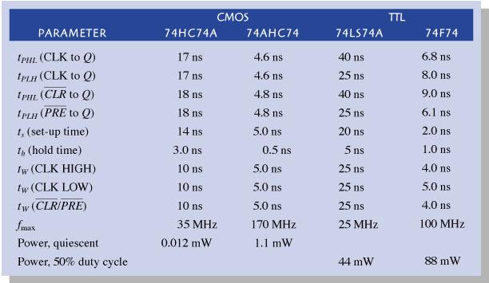
Comparison of operating parameters for 4 IC families of flip-flop of the same type

Slide 44
There are several other parameters that will also be listed in a manufacturers data sheet.
Maximum frequency (F_{max}) - The maximum frequency allowed at the clock input.
Clock pulse width (LOW) [t_{W}(L)] - The minimum width that is allowed at the clock input during the LOW level.
Clock pulse width (HIGH) [t_{W}(H)] - The minimum width that is allowed at the clock input during the high level.
Set or Reset pulse width (LOW) [t_{w}(L)] - The minimum width of the LOW pulse at the set or reset inputs.

Slide 45
Basic operation of a 555 Timer
Threshold
Control Voltage
Trigger
Discharge
Reset
Output

Slide 46
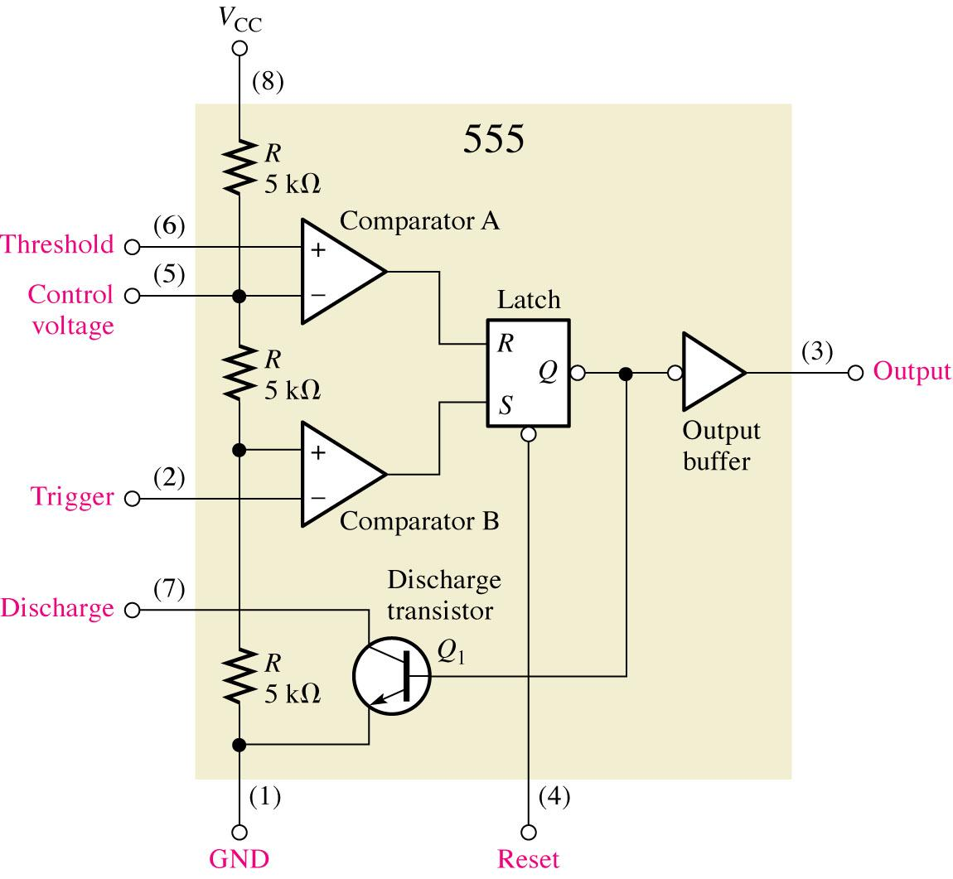
Functional Diagram of 555 Timer

Slide 47
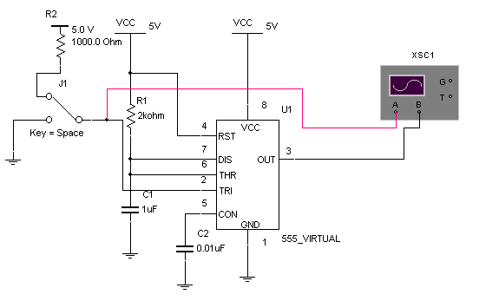
555 Timer as a one shot
t_{w} = 1.1R1C1 = 1.1(2000)(1F) = 2.2ms

Slide 48
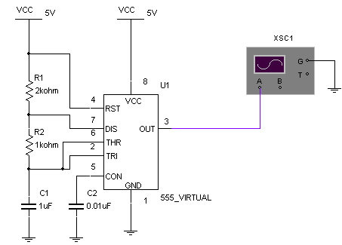
Astable operation of 555 Timer
t_{H} = .7 (R1+R2)C1 =2.1ms t_{L} = .7R2C1 = 0.7ms

Slide 49
3.2 Shift Register
~Basic shift register functions
~Serial in / serial out shift registers
~Serial in / parallel out shift registers
~Parallel in / serial out shift registers
~Parallel in / parallel out shift registers
~Bidirectional shift registers
~Shift register counters
~Shift register applications

